Slide 1



UIDAI DATA HACKATHON 2026
Aadhaar Service Intelligence System (ASIS)
A Spatial-Temporal Predictive Framework for Resource Optimization.
Focus: Telangana State Identity Infrastructure
Presented by: Team Trivarna
Team Lead
POLUSANI ARAVIND RAO
Team Members Roll Numbers
POLUSANI ARAVIND RAO(LEAD) 22S41A66E5
VEMULA NIKHIL 23S45A6610
SRIRAMULA GUNASHEKAR 22S41A66H2

Slide 2
Agenda
Vision & Context: Aadhaar as a Digital Public Infrastructure (DPI).
Problem Definition: Identifying systemic latencies and service gaps.
Technical Architecture: The ASIS "Plumbing" and Data Pipeline.
Methodology: Mathematical formulation of the Service Stress Index.
Key Performance Indicators: Data insights from the Telangana dataset.
Strategic Recommendations: Proactive resource allocation & scalability.
Conclusion & Future Roadmap.

Slide 3

The Core Challenge
"Systemic Inefficiency in Aadhaar Service Delivery“
Spatial Imbalance: 50% of the load is concentrated in 10% of districts (e.g., Hyderabad & K.V. Rangareddy).
Temporal Latency: Static staffing models fail during predictable surges (e.g., Friday Peak Load).
Infrastructure Gaps: Low Digital Inclusion Scores (0.10) in rural sectors like Jangoan.
Result: Long wait times, system fatigue, and citizen friction.

Slide 4
The ASIS Solution
"Data-Driven Intelligence Layer“
What it is: A predictive analytical engine that monitors the Service Stress Index ($\sigma$).
How it works: It processes anonymized enrolment logs to identify precisely where and when service bottlenecks will occur.
Technical Edge: Built on a columnar storage architecture capable of processing 91 Million+ records in real-time.

Slide 5
System Architecture
"From Raw Logs to Actionable Dashboard“
Ingestion: Secure streaming of anonymized logs from CIDR.
Processing: Automated cleaning and normalization of demographic
data (Age, Pincode, Date).
Intelligence Tier: DAX-based modeling of Growth Momentum and Dependency Indexes.
Visualization: High-fidelity Power BI Dashboard for real-time monitoring.

Slide 6
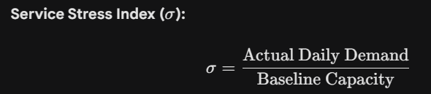
Methodology (The "Science")
Mathematical Validation of Service Load
Service Stress Index:
Current Telangana Index: 1.00 (Indicates system is operating at 100% capacity).
Digital Inclusion Score: Measures service reach vs. population density.
State Average: 0.17 | Target: 0.25.

Slide 7
Key Performance Indicators (KPIs)
Metric | Value | Insight
Total Daily Demand | 826K | Significant state-wide throughput.
Youth Aadhaar | 122K | 14.78% of total load; priority for schools.
Peak Load Day | Friday | Critical day for maximum resource deployment.
Dependency Index | 52,603 | High citizen reliance on digital identity.

Slide 8
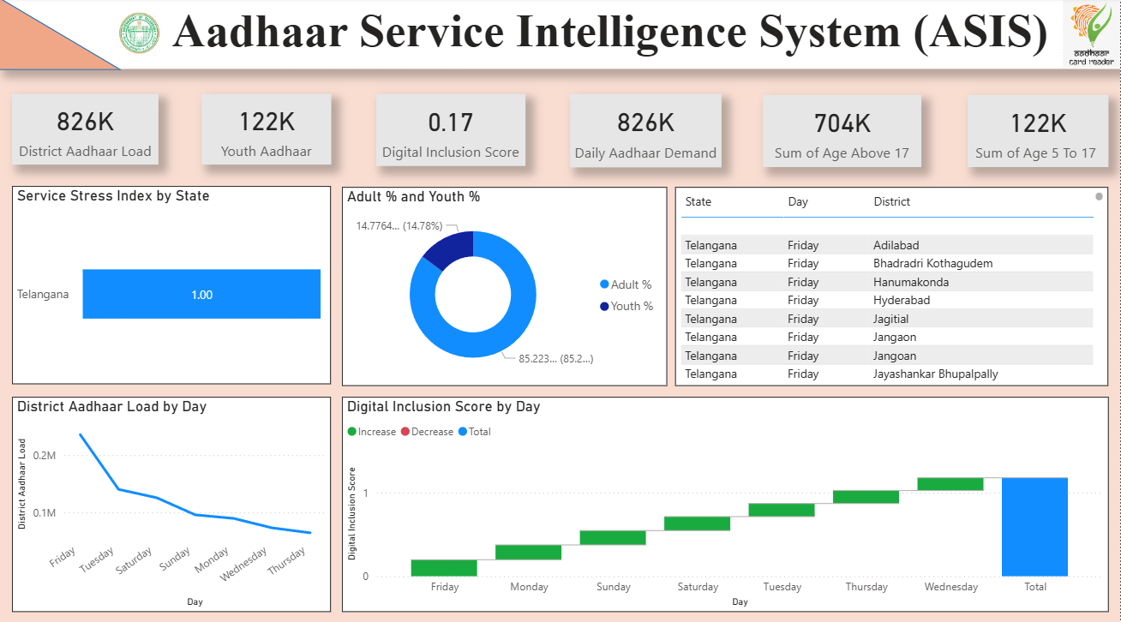

Slide 9
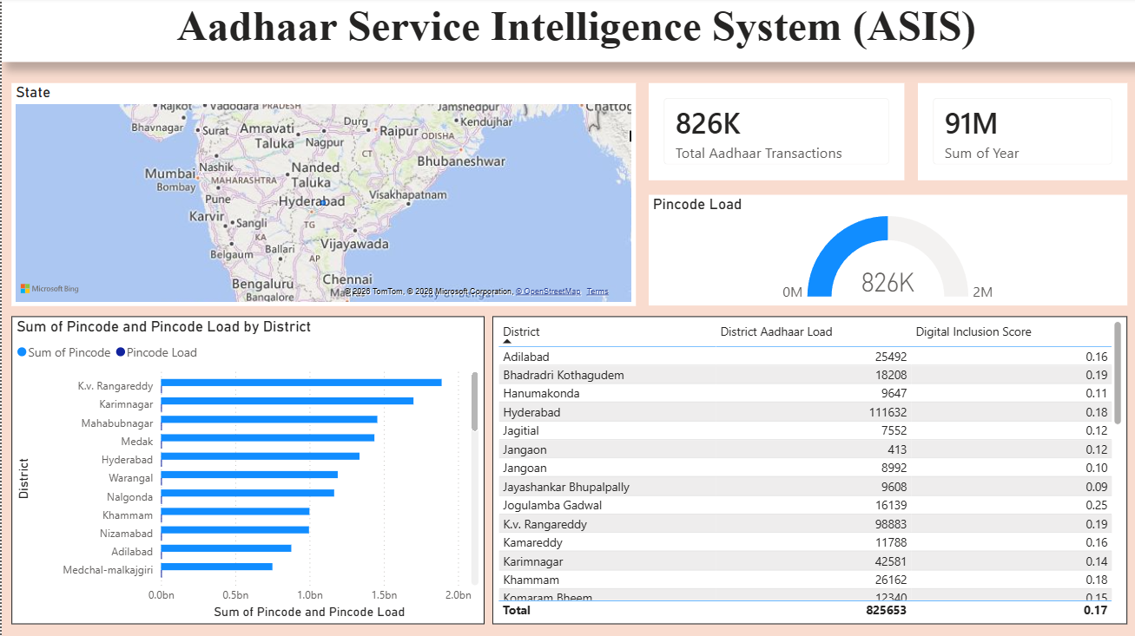

Slide 10
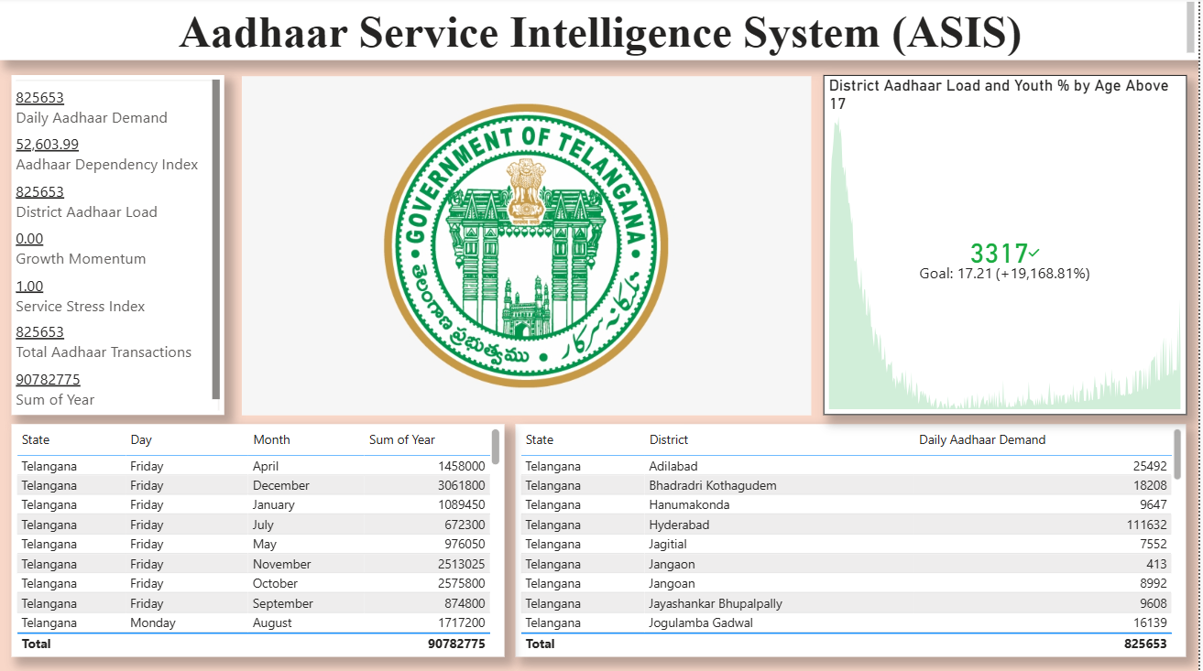

Slide 11
Spatial & Temporal Insights
"Where and When the System Breaks“
Temporal Trend: Demand starts high on Friday (>0.2M) and tapers off toward the weekend.
Spatial Hotspots: * Hyderabad: 111,632 (Highest Load)
  K.V. Rangareddy: 98,883
Actionable Insight: Proposing a 15% staff reallocation from midweek to Fridays in Urban Clusters.

Slide 12
Real-World Impact
Citizen Centric: Reduces average wait times by predicting and managing queues before they form.
Resource Efficiency: Prevents over-staffing in rural districts and under-staffing in urban hubs.
Scalability: The framework is "Plug-and-Play" for any state or the entire Pan-India CIDR repository.

Slide 13
Conclusion & Roadmap
Conclusion: ASIS transforms Aadhaar from a static record system into a dynamic service ecosystem. It ensures that the "Digital Identity" promise is matched by "Operational Excellence.“
The Roadmap:
Phase 1: Real-time API integration with State Data Portals.
Phase 2: AI-driven predictive staffing alerts for District Collectors.
Phase 3: Dynamic appointment re-routing for citizens via the Aadhaar App.

Slide 14
Thank You!
Aadhaar Service Intelligence System (ASIS)
Building a Resilient Digital Public Infrastructure

